Slide 1
Seattle Traffic Accident Severity Prediction
Narcís Gironès Sancho
16 September 2020

Slide 2
Index
I. Introduction
II. Data
III. Methodology
IV. Result
V. Discussion
VI. Conclusion

Slide 3
I. Introduction
Background
Business Problem
Target Audience
Do you live in a safe city?
Can your children walk safe
and free?
Is Seattle a city for tourists?
Seattle is one of the cities with the most car collisions in the United States.
Analyze and study the collision dataset for the city of Seattle, Washington.
Find patterns and determinate key factors to create the best traffic accident severity prediction.
Use various analytical techniques and machine learning classification algorithms.
Government departments
Car rental companies
Insurance companies
Emergency services
Make recommendations to reduce accidents.

Slide 4
II. Data
Source
Department of Transportation traffic accident data from 2004 to present for Seattle, Washington
Metadata
Dataset with 194,673 instances (rows) and 38 features (columns) of traffic accidents
Each collision has the attribute of a severity code:
3—fatality 2b—serious injury 2—injury 1—property damage 0—unknown

Slide 5
III. Methodology
Data Analysis
Data Encoding
Feature Set and Normalization
Machine Learning Model

Slide 6

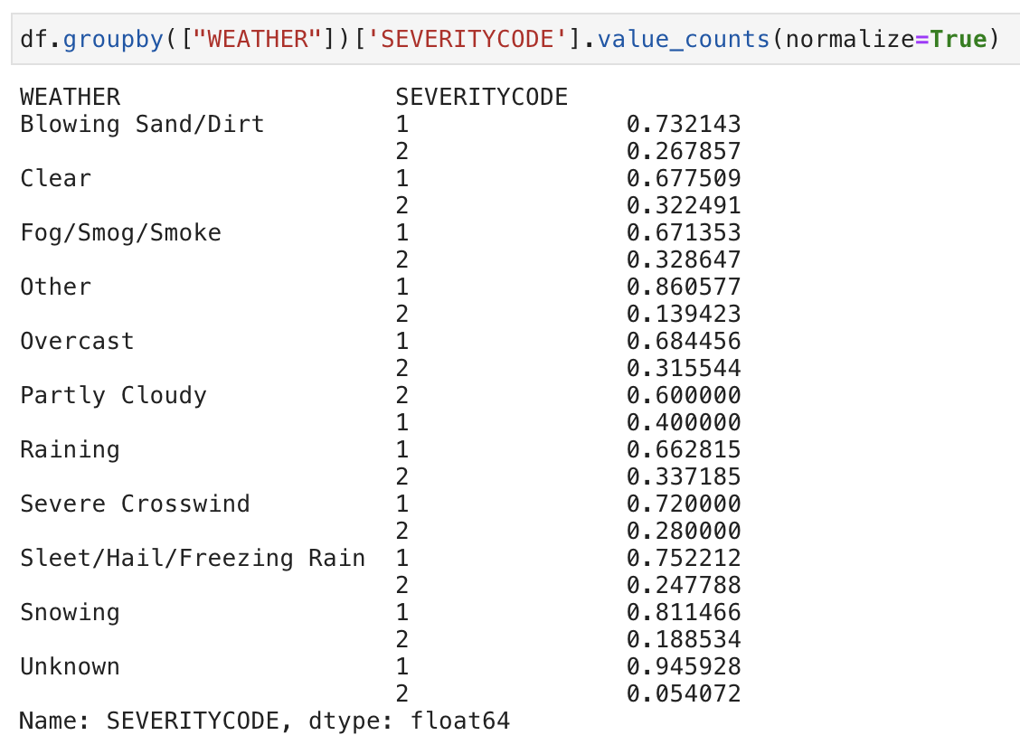
Data Analysis
How can we determine which features can be used to most accurately predict severity code?
Add new column with the day of the week to find out if there are more accidents on the weekend than during the work week.
dataframe.groupby([feature])['SEVERITYCODE'].value_count()

Slide 7

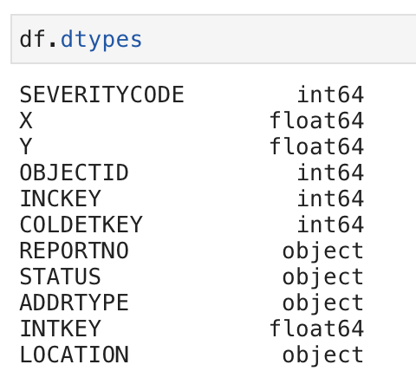
Data Encoding
Know what type of data we have
Most of the Machine Learning models work with numerical data:
Int64
Float64
Convert our data set to a numeric type using this method with an example:
df['ADDRTYPE'].replace(to_replace=['Alley','Block','Intersection’], value=[0,1,2],inplace=True)

Slide 8

Feature Set and Normalization
Feature set consists of 14 columns:
To avoid any bias:
Remove NaN’s
Normalize our dataset
X=features[['ADDRTYPE','JUNCTIONTYPE','COLLISIONTYPE','VEHCOUNT','PEDCYLCOUNT','PERSONCOUNT','PEDCOUNT','SDOT_COLCODE','ROADCOND','LIGHTCOND','WEATHER','PEDROWNOTGRNT','SPEEDING','HITPARKEDCAR']]
features.dropna(inplace=True)
preprocessing.StandardScaler().fit(X).transform(X)

Slide 9

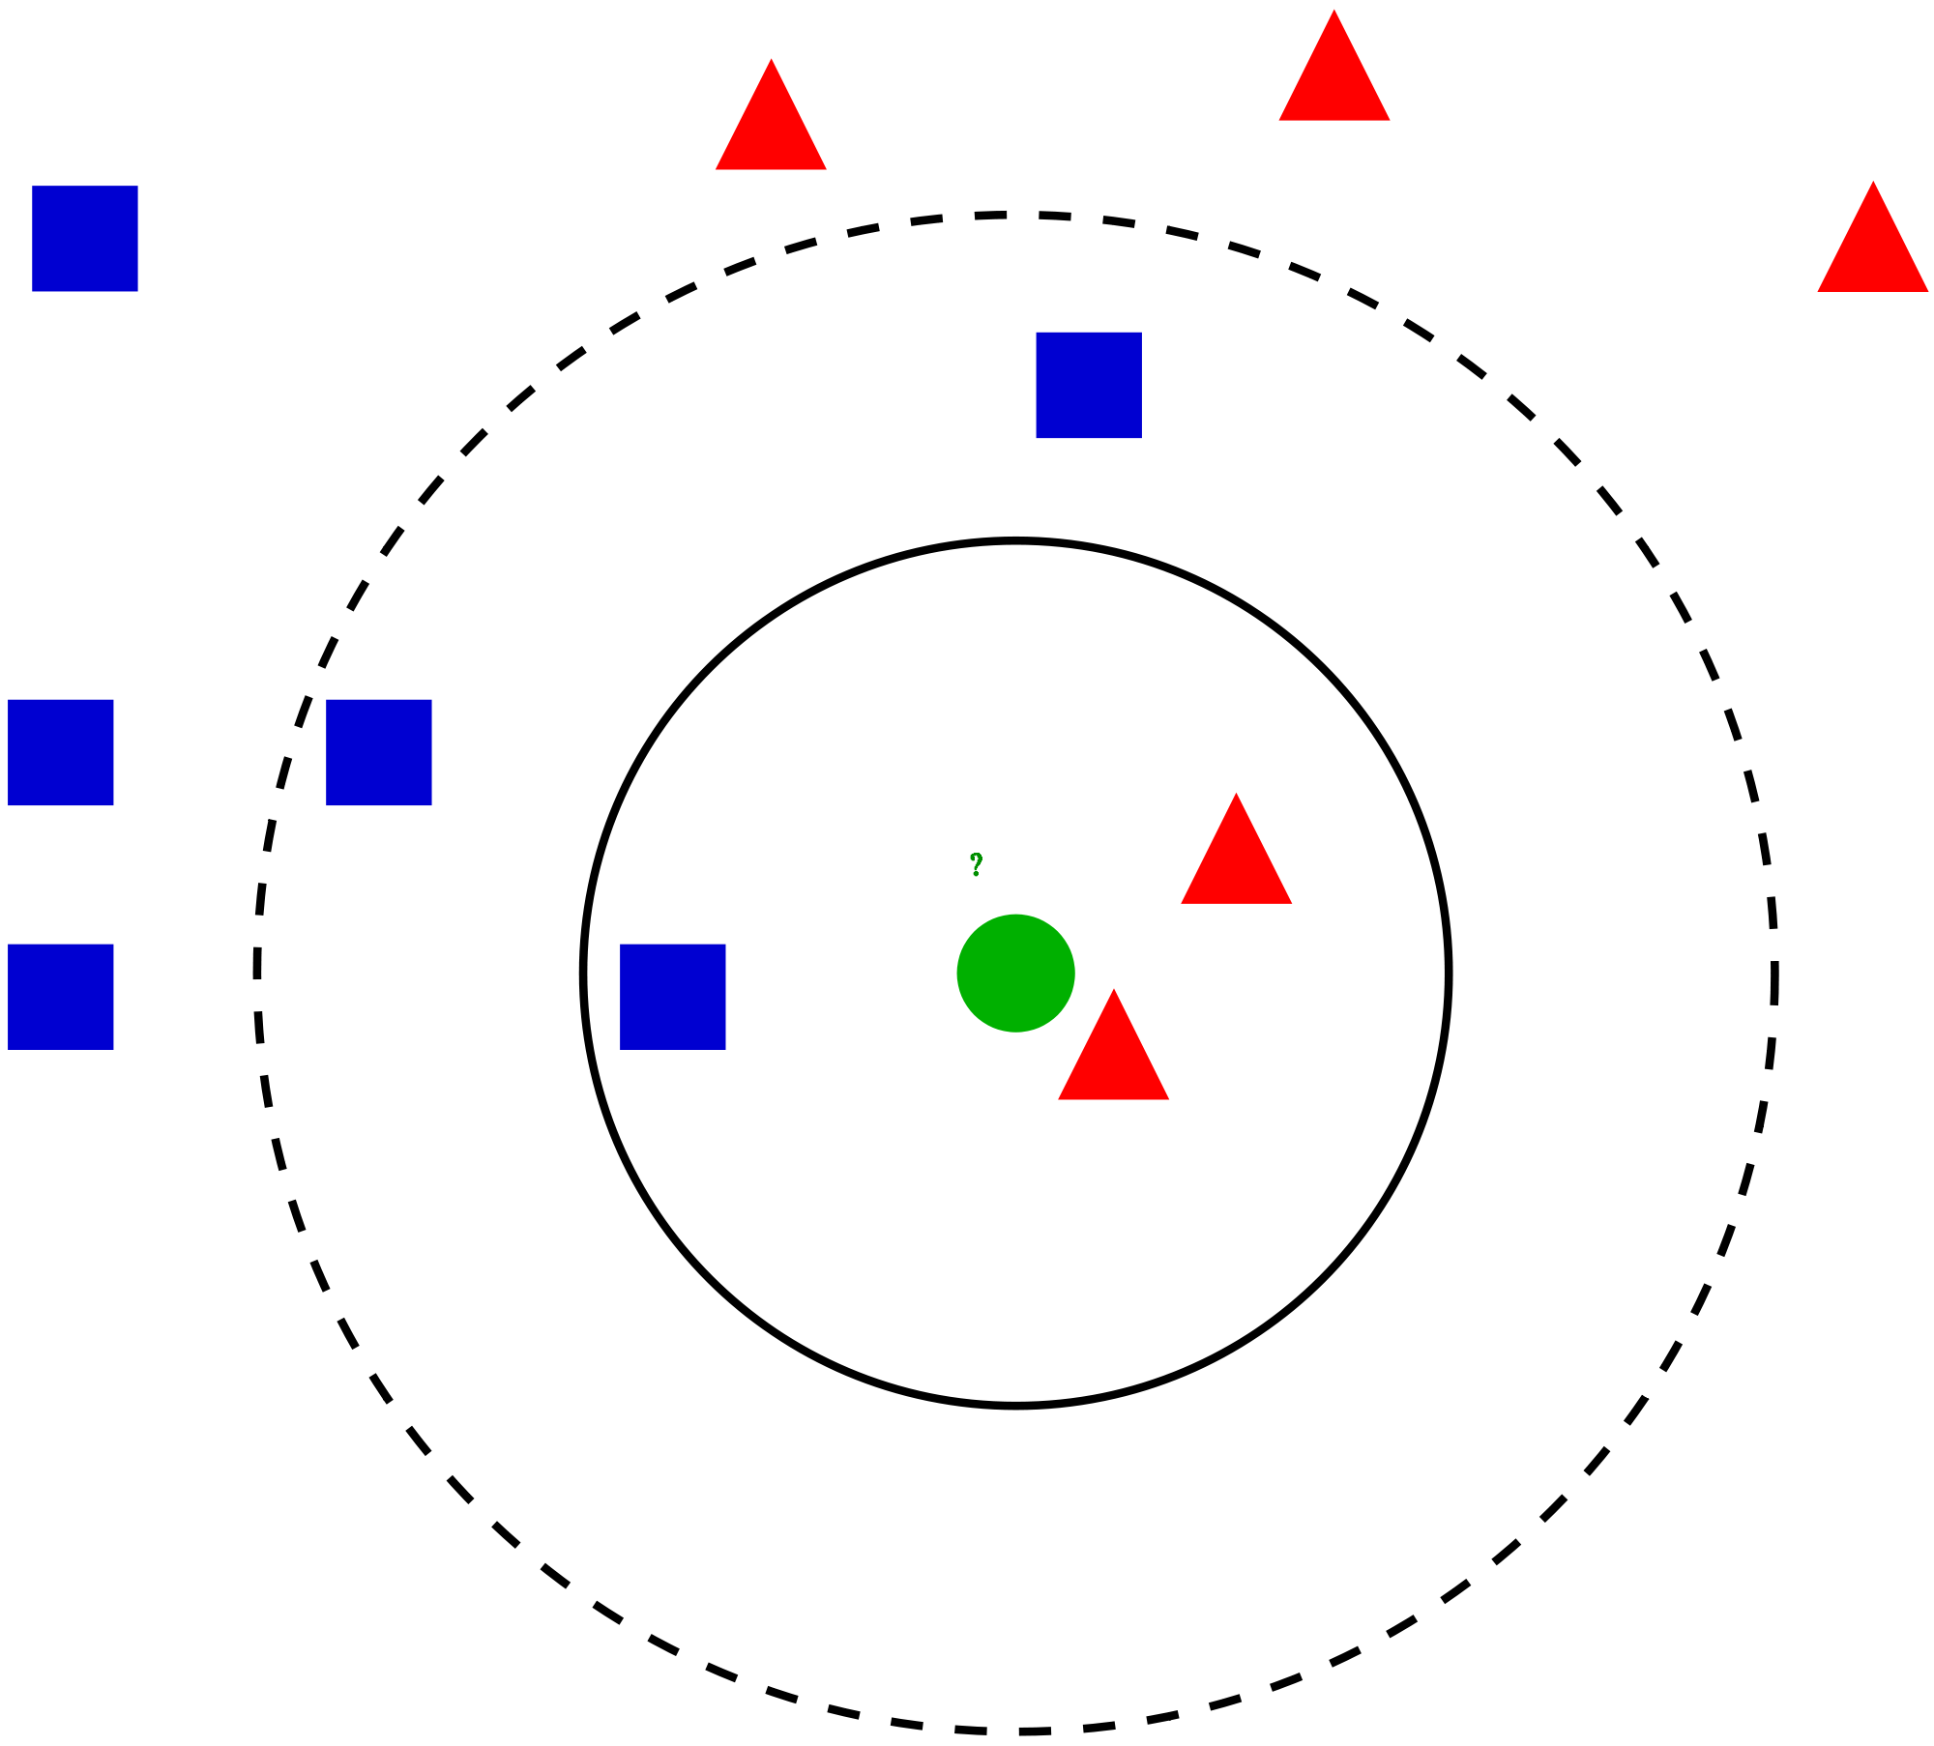

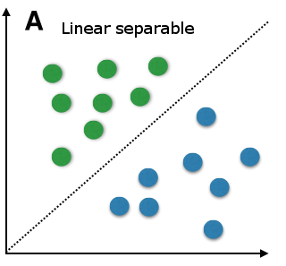
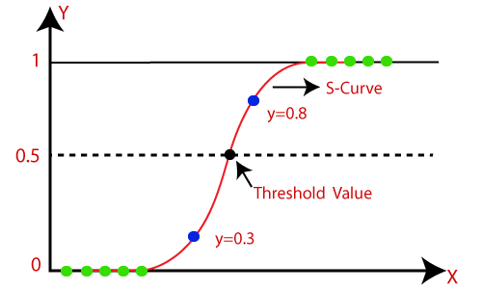
Machine Learning Model
Machine Learning classification models have been studied to classify the severity code of an accident
Feature set must first be divided into:
Training set (80%) to train the models
Test set (20%) to test the models
K Nearest Neighbor
Decision Tree
Support Vector Machine
Logistic Regression
X_train, X_test, y_train, y_test = train_test_split( X, y, test_size=0.2, random_state=4)

Slide 10
IV. Result
How we can decide the best model?
Jaccard Similarity
F1 – Score
Computing Time
After training and testing all the models
Compared to the other models, the Decision Tree computing time was instantaneous. The other models took around 2 hours each.
Computing time was the most important factor in deciding which model is the best.
Based on accuracy and computing time, I recommend the Decision Tree model for implementing the Traffic Accident Severity.

Slide 11
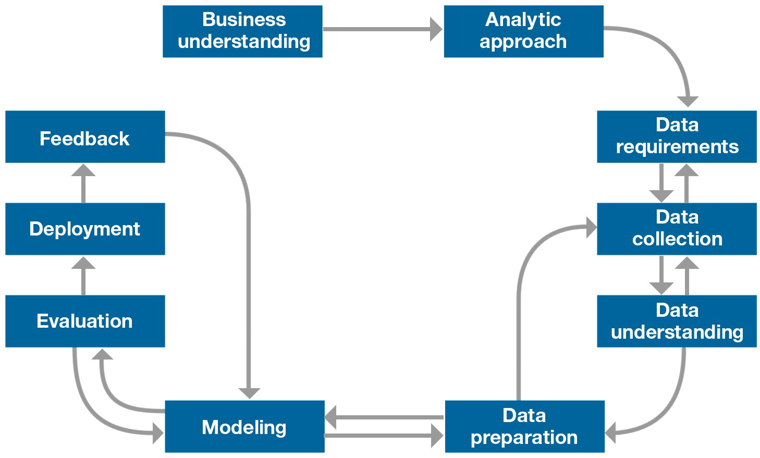
V. Discussion
Realize how important methodology is for Data Science
Invest time in these three initial phases for building our model to have a successful outcome.
When I was preparing the data, I wondered …
Are there more accidents on the weekend?
Find pattern to prevent accidents:
Weather condition
Road condition
Light condition
Visualize high risk points on a map
1
From problem to approach
From requirements to collection
From understanding to preparation
2
3

Slide 12
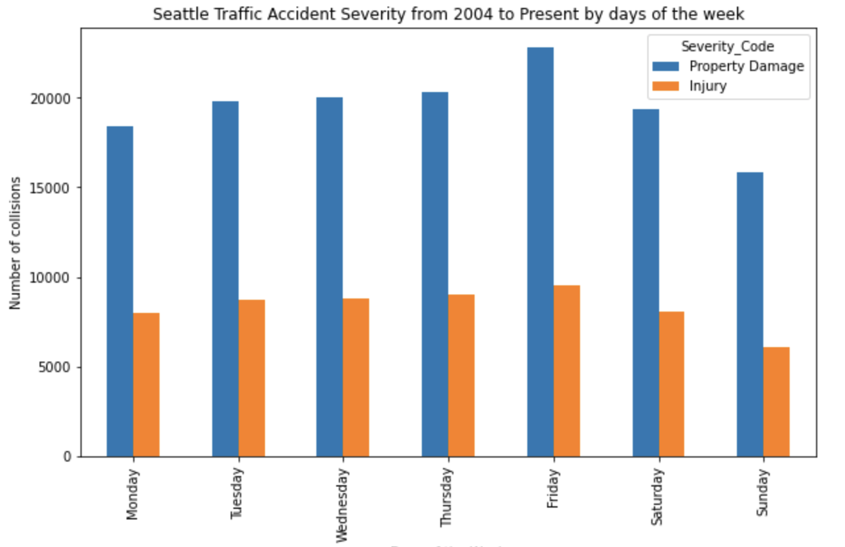
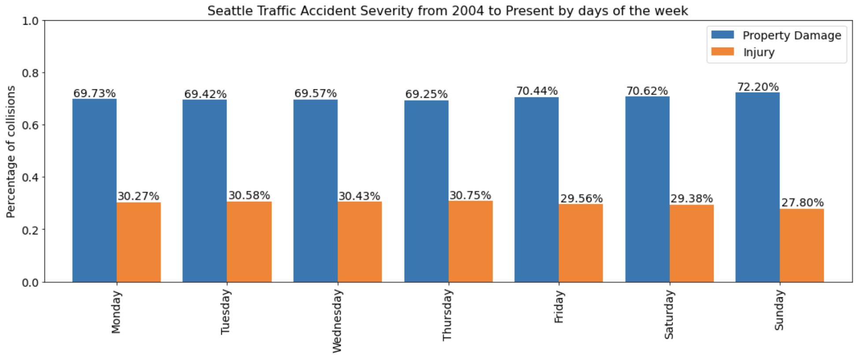
V. Discussion - Are there more accidents on the weekend?
No clear difference between number or severity of weekend and weekday traffic accidents

Slide 13
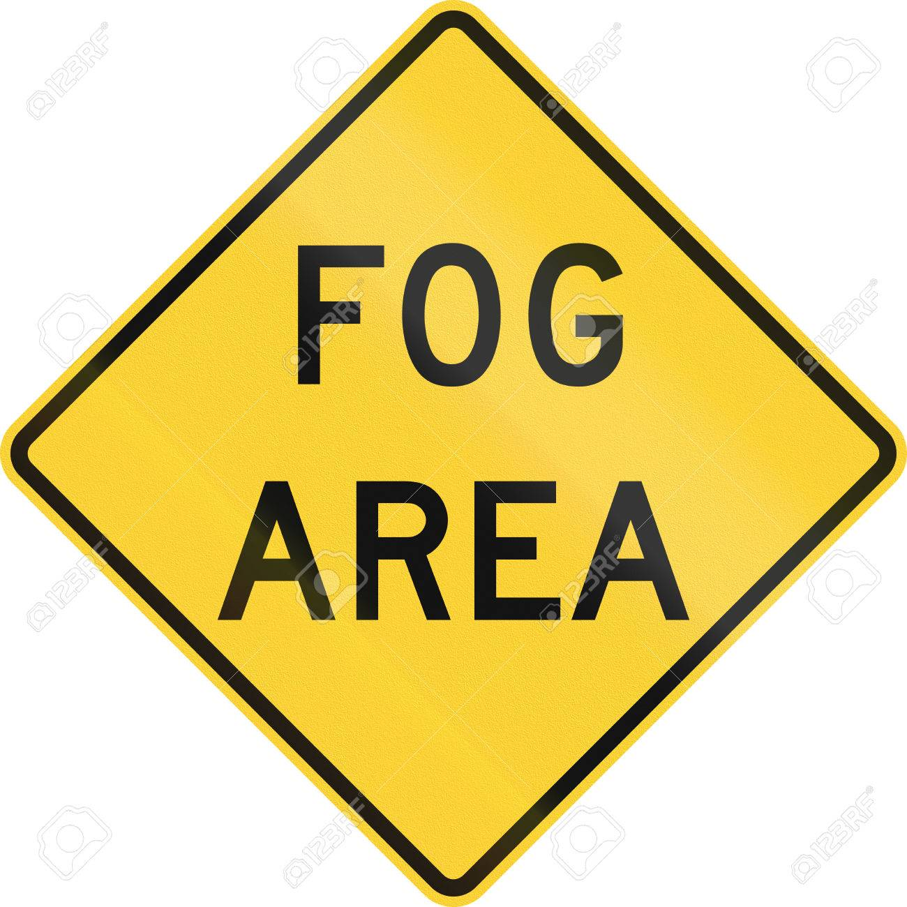
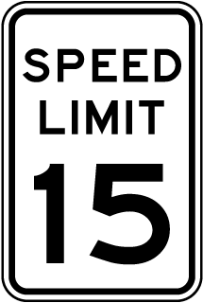
V. Discussion - Find pattern with weather and road condition
Good: "Clear", "Overcast", "Partly Cloudy" Reduce Visibility: "Raining", "Snowing", "Fog/Smog/Smoke", "Sleet/Hail/Freezing Rain", "Blowing Sand/Dirt" Windy: "Severe Crosswind"
Based on both graphs, the majority of the accidents have suffered on good conditions, but we could analyze the accidents suffered on reduce visibility and wet roads in case of finding a pattern and being able to prevent accidents by incorporating traffic signs.
Visibility sings
Speed sings

Slide 14
V. Discussion - Find pattern with light condition
Bad: "Dark - No Street Lights", "Dark - Street Lights Off", "Dark - Unknown Lighting" Good: "Daylight" Medium: "Dark - Street Lights On", "Dusk", "Dawn"
Accidents occurred under ‘Good’ or ‘Medium’ lighting conditions, with just about 1% of accidents occurring under ‘Bad’ lighting conditions.
"Medium" type of light condition could be studied in depth in case more road lights could be renewed or added

Slide 15
V. Discussion - Visualize high risk points on a map
Using the package ‘folium’
Due to the high compilation time, the study was only possible with the first 1000 accidents.
Although some areas on the map have a higher number of collisions, no specific sections of road were identifiable as a high-risk points.
Using a high SPEC computer, this analysis could be a valuable source of information for city planning and locating areas for infrastructure improvements.
Prevent accidents
Help Seattle become a safer city to drive in

Slide 16
VI. Conclusion
Wet conditions contribute to about one-quarter of traffic accidents resulting in property damage, while 96% of accidents resulting in injury occurred in dry conditions.
Infrastructure maintenance
Speed enforcement
The majority of accidents occurred under ‘Good’ or ‘Medium’ lighting conditions, with just about 1% of accidents occurring under ‘Bad’ lighting conditions.
More caution and speed limits should be enforced during reduced visibility and wet conditions since they are the second leading cause of car accidents.
Adding new signs and lights will be very helpful in cautioning drivers at dusk, dawn and at night.

